Slide 1
I. Introduction to the Heart and Cardiovascular System
Supplies the entire body with oxygen and nutrients and removes waste products.
The heart is the pump
Cardiac output (CO) = 5 L/min
10,000 L/day
4,000,000 L of blood per year
One of the two most important organs in the body
Cardiovascular disease is the most common cause of death in the US and, indeed, the world.

Slide 2
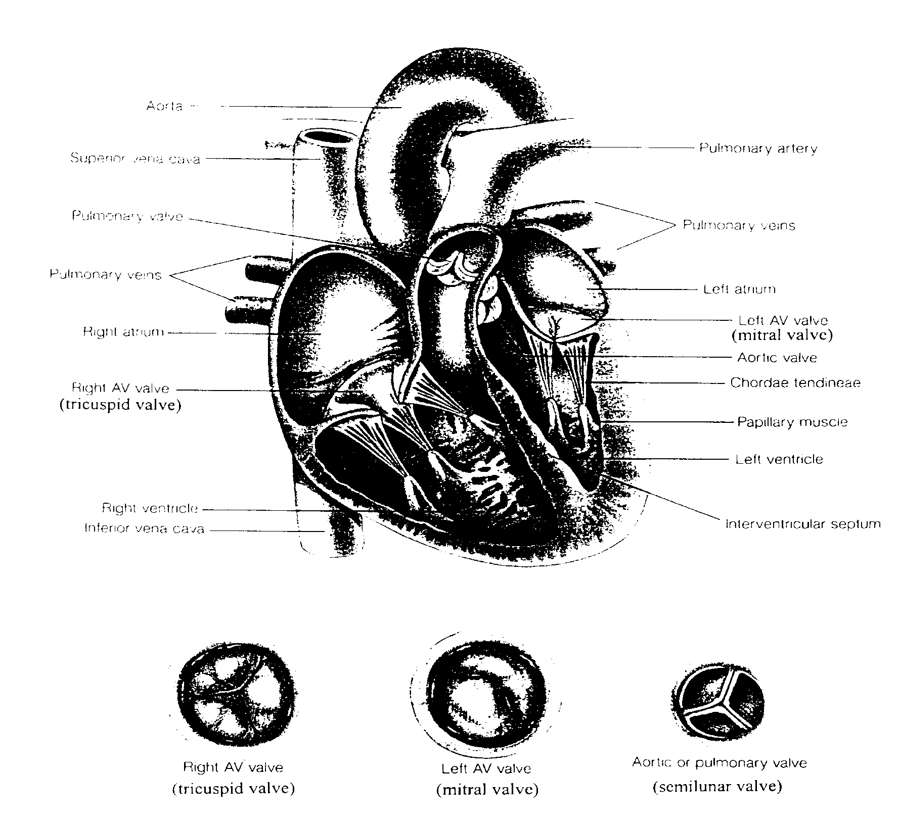

Slide 3
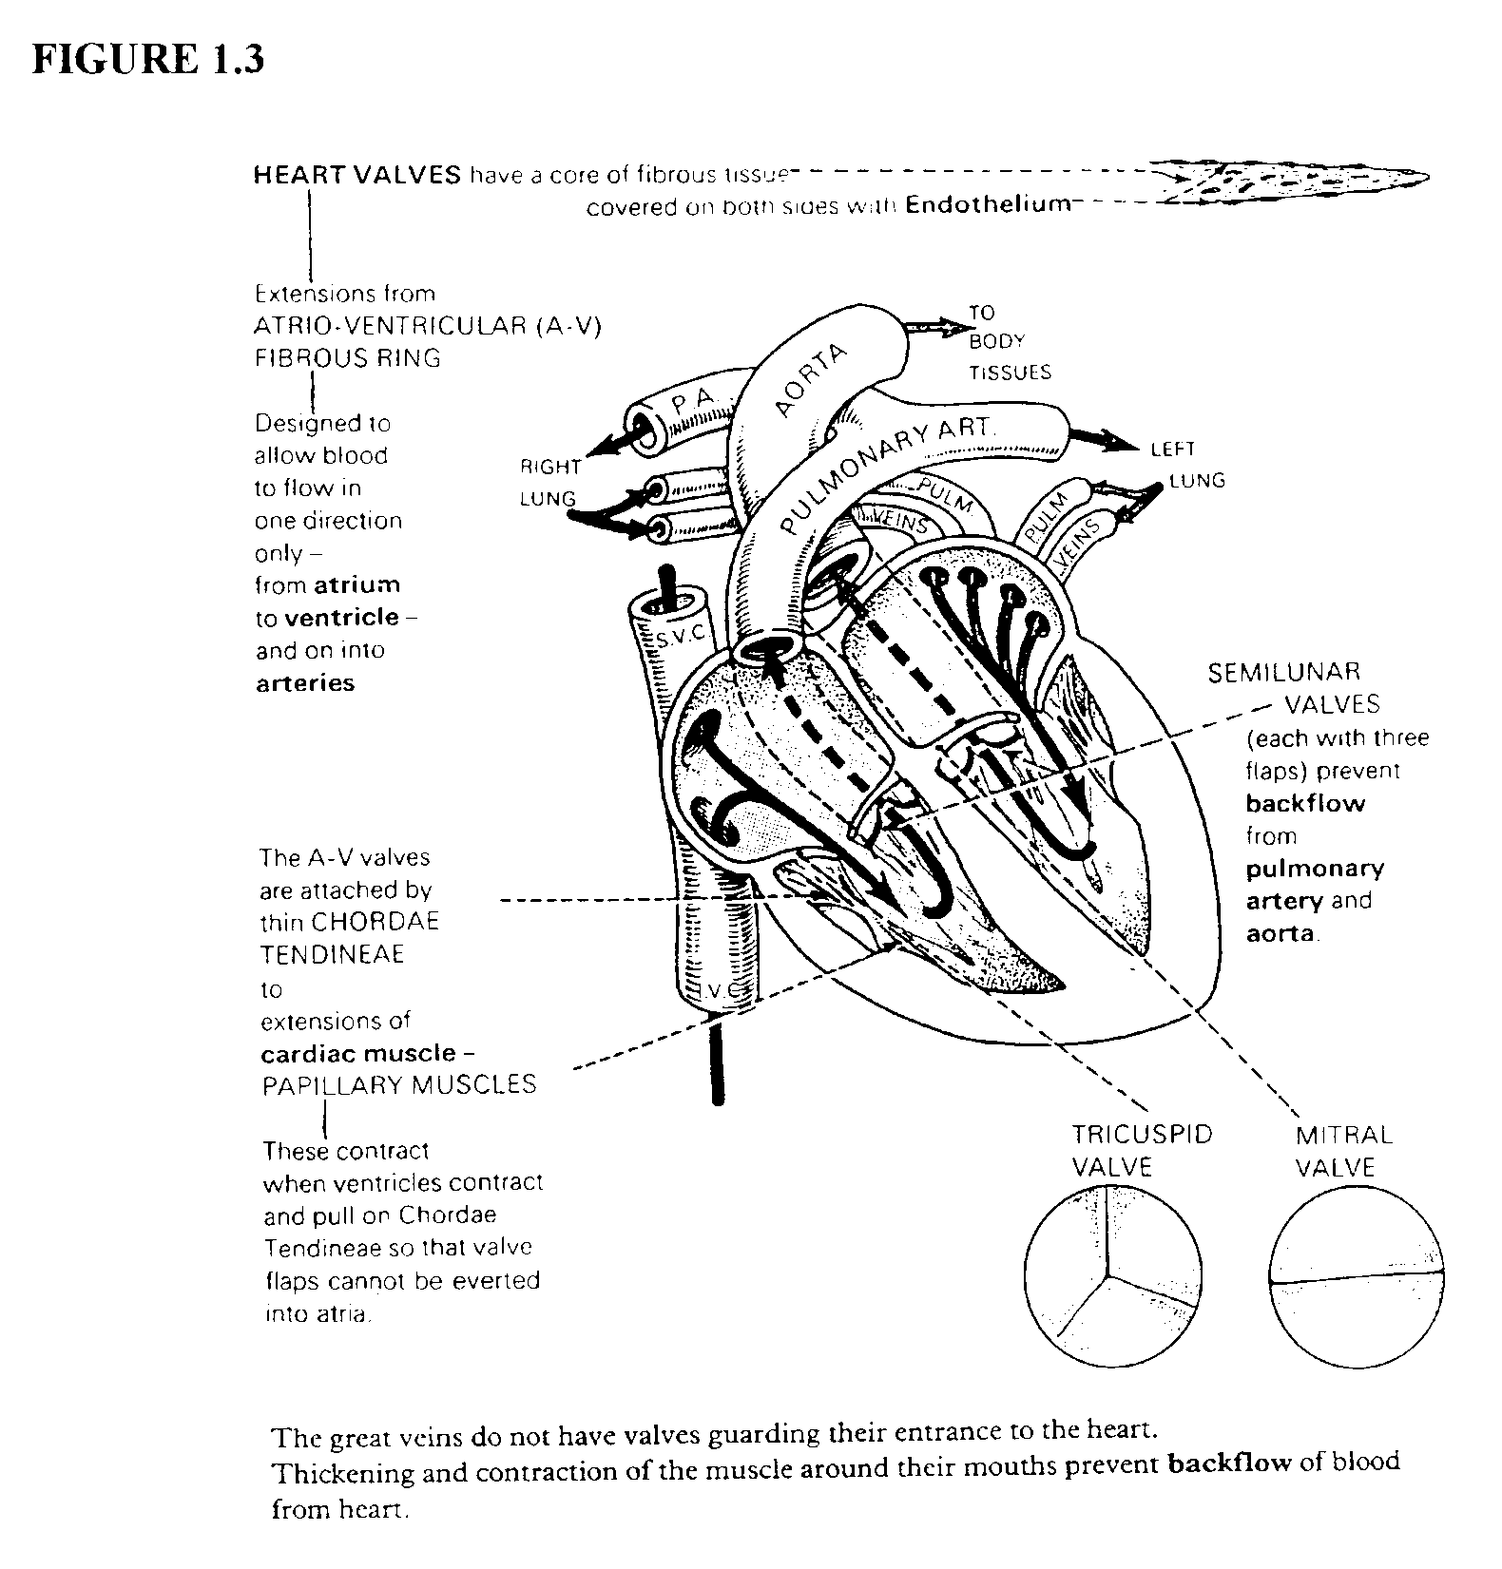
Diastole
Vena Cava
Rt. Atrium
Lt. Atrium
Tricuspid Valve
Mitral Valve
Rt. Ventricle
Lt. Ventricle
Pulm. Valve
Aortic Valve
Systole
Pulm. A.
Aorta
Systemic Circulation
Pulm. Circ.
Systemic Circ.
Systemic Circulation

Slide 4

Echocardiogram

Slide 5
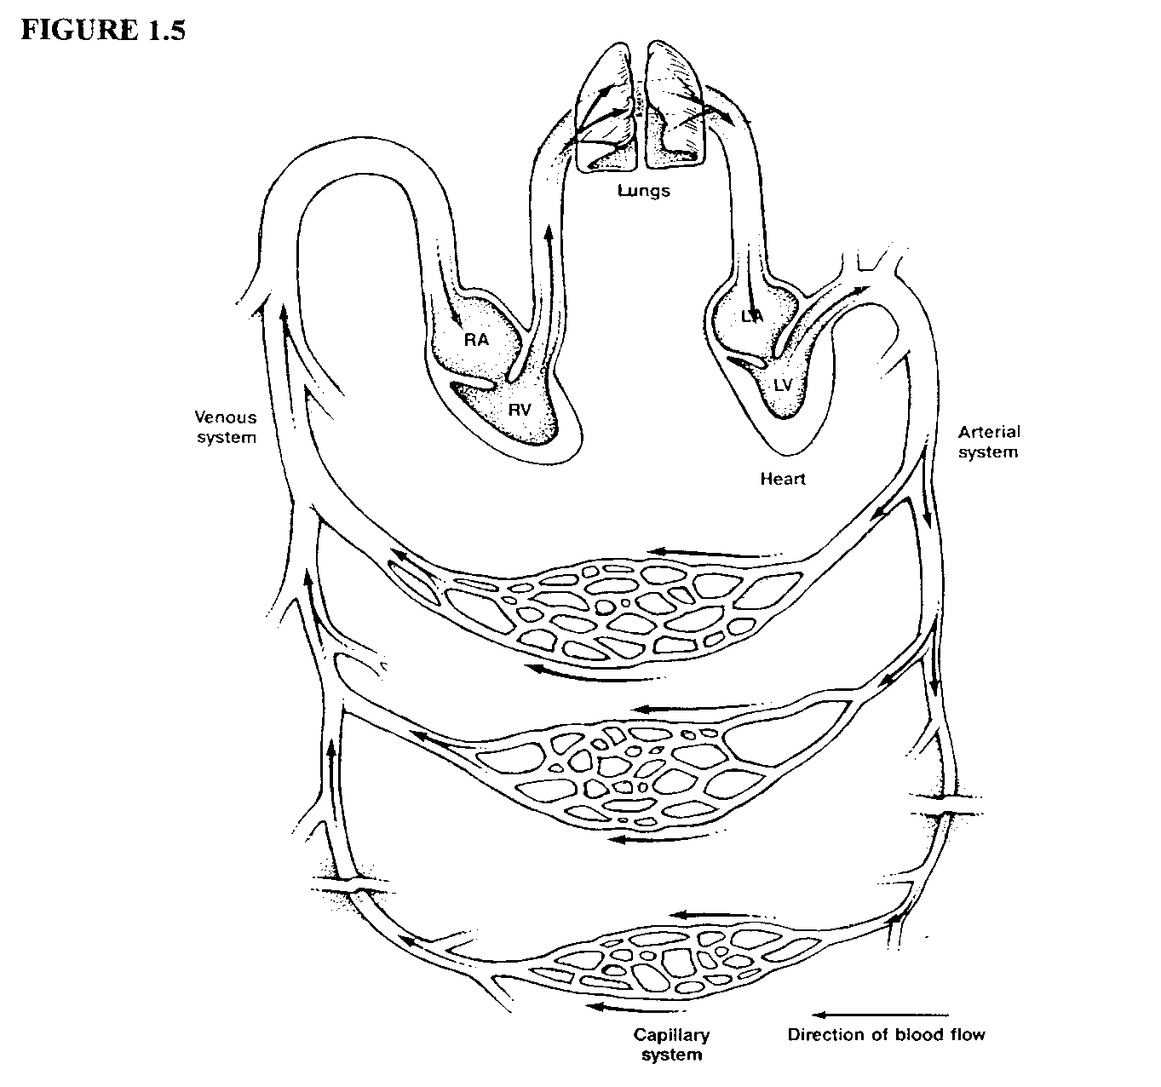
2 pumps
Right heart
Left heart
These pumps are in series. Therefore the flow on each side must be the same.

Slide 6
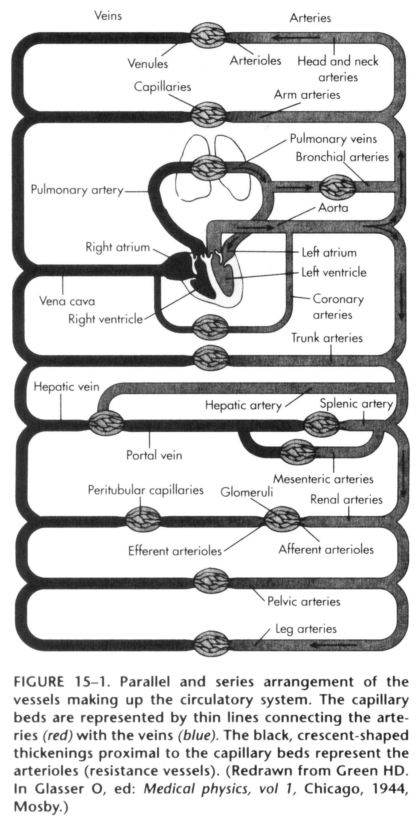
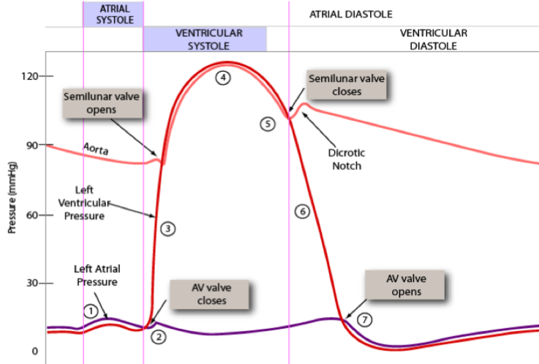
Systemic Circulation
Perfuses everything except the lungs
Regional beds are in parallel. Perfusion is controlled according to the needs of each region.

Slide 7
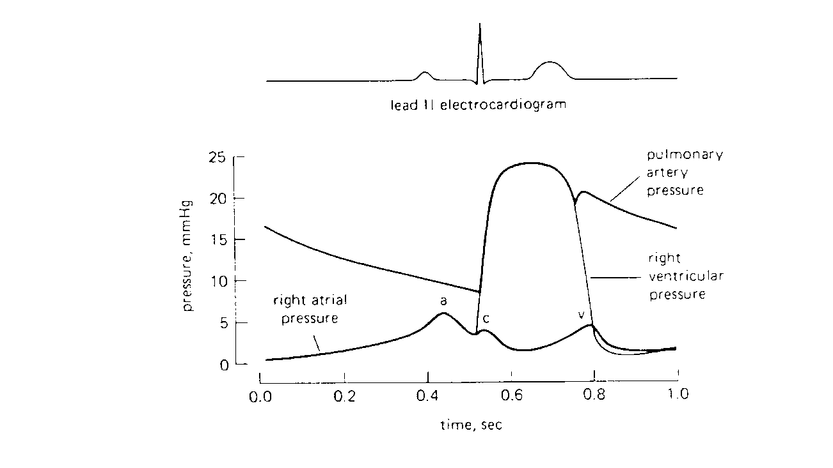
Pulmonary Circulation
Perfuses the gas exchange portion of the lungs
Walls of the vessels are highly compliant

Slide 8
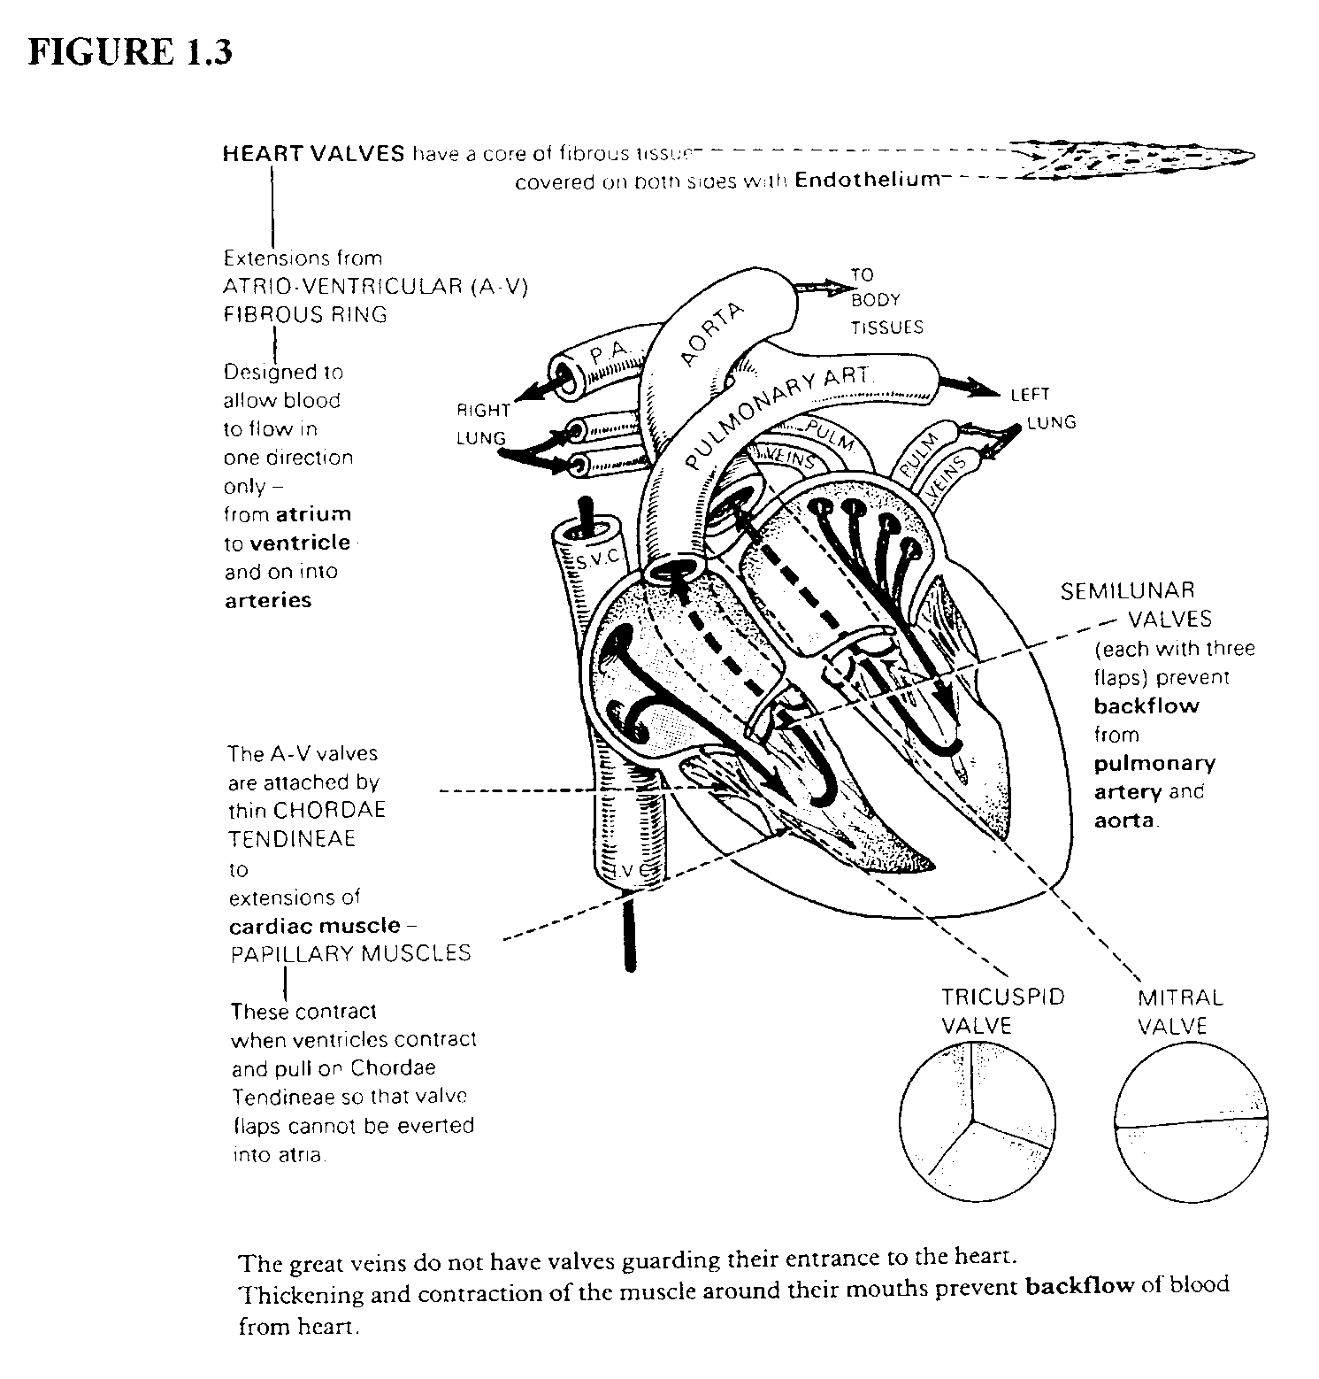
Cardiac Output (CO): The cardiac output is the amount of blood leaving each ventricle per minute.
CO = HR x SV
HR ≈ 70 /min [60-180, controlled by ANS]
SV = 70-75 ml [70-120]
70(72)=5000 ml/min

Slide 9
Low Pressure
High Pressure
MAP = mean arterial pressure
CO = HR(SV)
MAP = CO (TPR)
TPR = total peripheral resistance

Slide 10
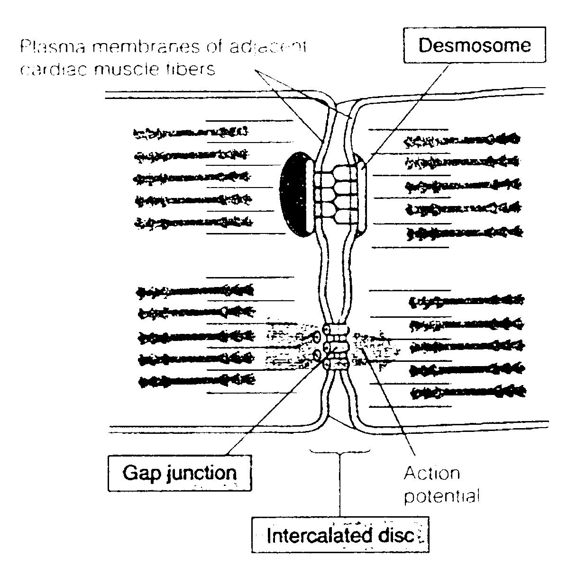
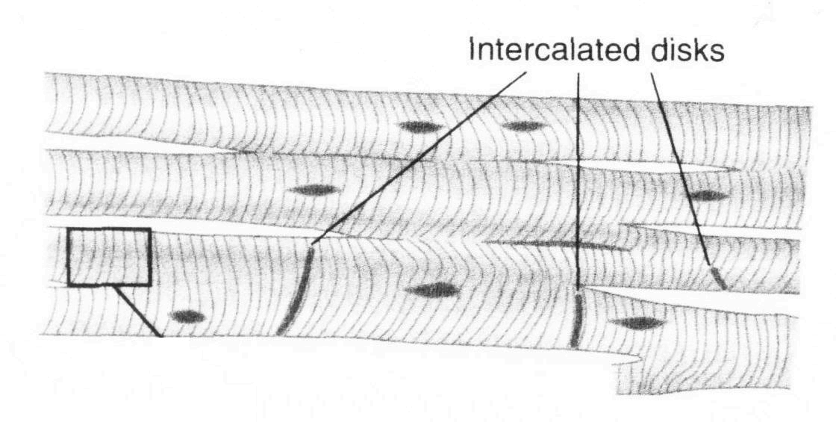
contract – syncytium
dimensions
intercalated discs
desmosomes
gap junctions
Spread of the action potential

Slide 11
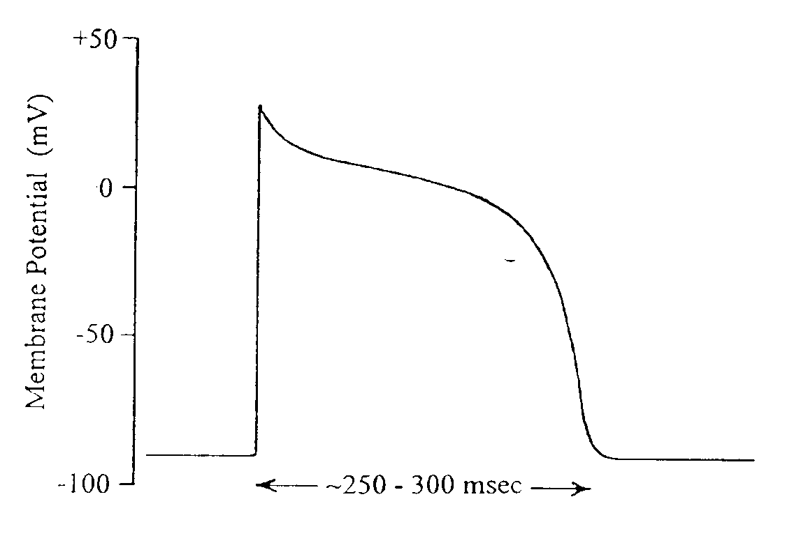
transmembrane potential measurement
resting potential
propagate via gap junctions
Contraction is triggered by the AP
Ca from Ca channels
Ca from the sarcoplasmic reticulum

Slide 12
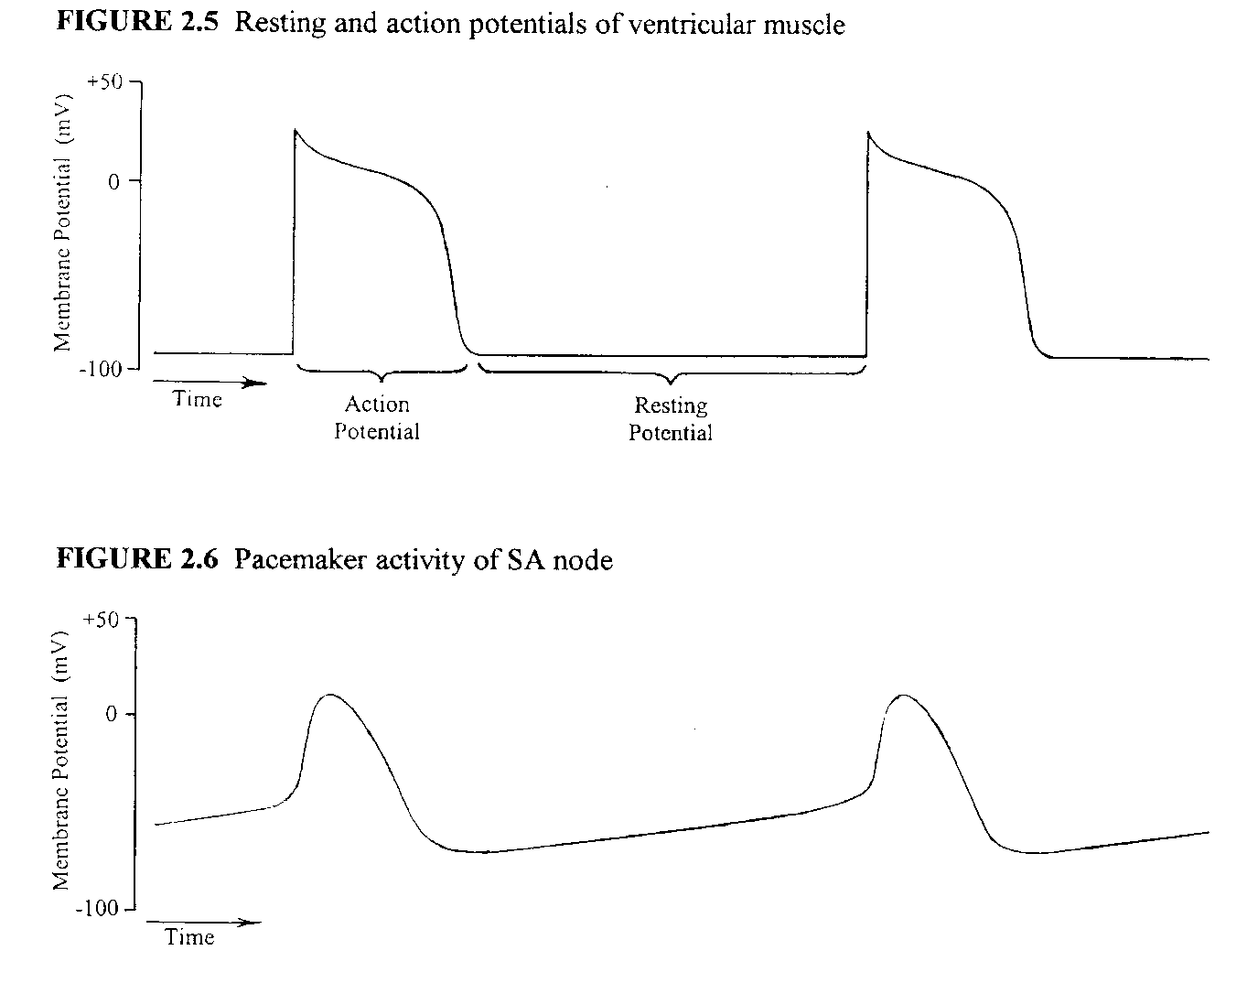
V_{M} Inside with respect to outside
SA node is the pacemeker for the heart

Slide 13
TABLE 2.1 Extracellular Fluid: Sodium (Na⁺) 135-145 mM Potassium (K⁺) 3.5 - 5.0 mM Calcium (Ca²⁺) 2.0 - 2.6 mM Chloride (Cl⁻) 98 - 106 mM Intracellular Fluid: Sodium (Na⁺) about 10-15 mM Potassium (K⁺) about 140 mM Calcium (Ca²⁺) about 50 nM Chloride (Cl⁻) about 10 mM Extracellular fluid concentrations are typical adult plasma levels as listed in Mohrman and Heller, 1997. Intracellular fluid concentrations are approximate typical values.
Na/K ATPase
Ca pumps
Na/Ca exchanger

Slide 14
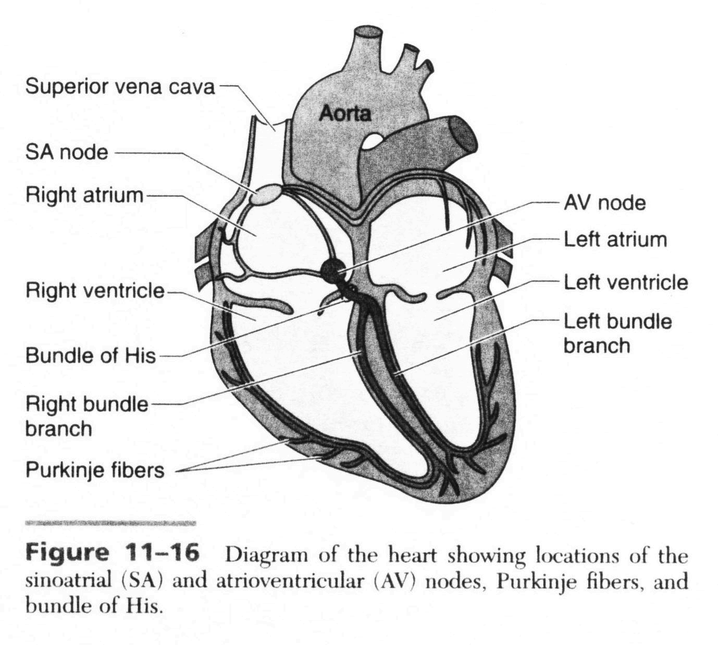
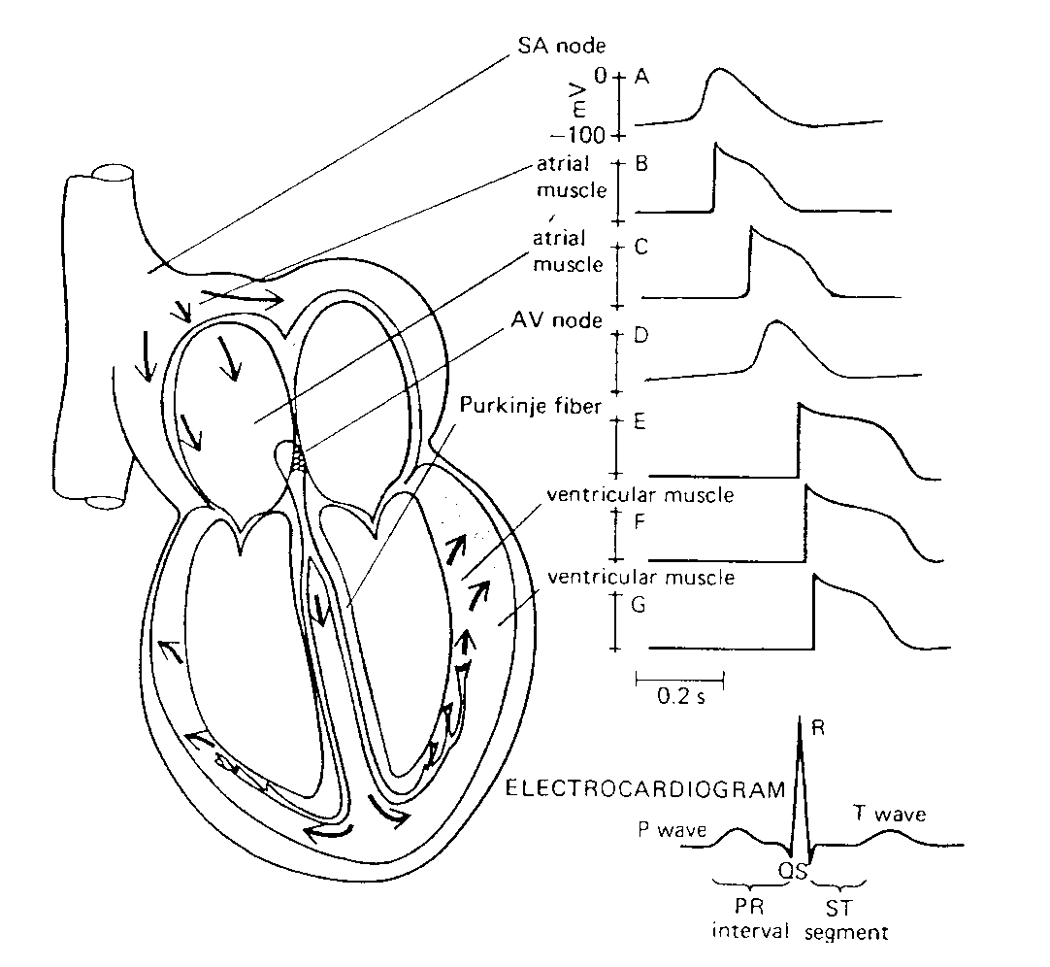
Action potentials propagate
SA node
Atria (100 ms)
AV node
only electrical connection
propagation is very slow – AV nodal delay
bundle of His
right and left bundle branches
Purkinje fiber network
Spread through ventricular wall

Slide 15
Ca Channels
Gated (opened) by voltage (action potential)
Ca flows into the cell down its concentration gradient and increases cytosolic [Ca] causing contraction.

Slide 16
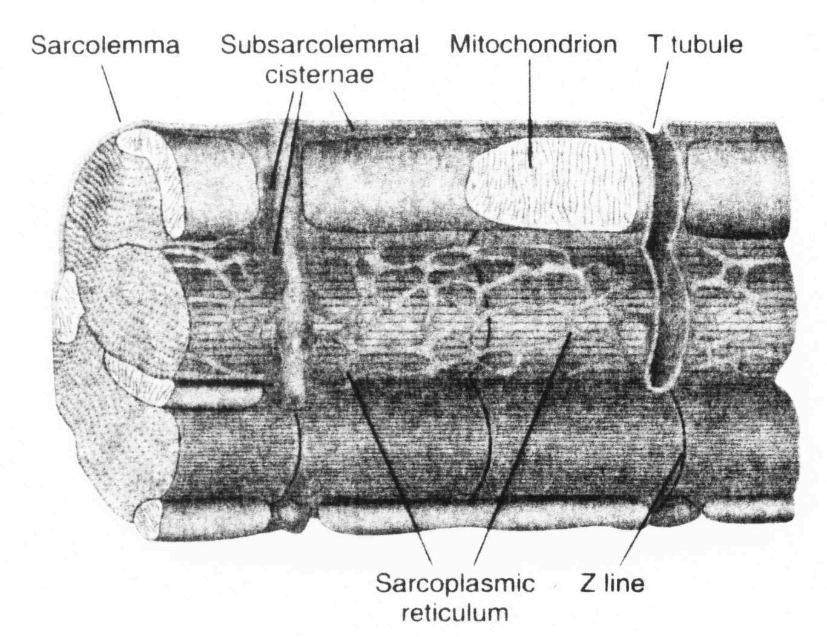
Sarcoplasmic reticulum (SR, endoplasmic reticulum)
Intracellular organelle
SR Ca pump
SR Ca release channel (ryanodine receptors)
Transverse tubule or T-tubule
triggered by increased Ca (Ca induced Ca release)

Slide 17
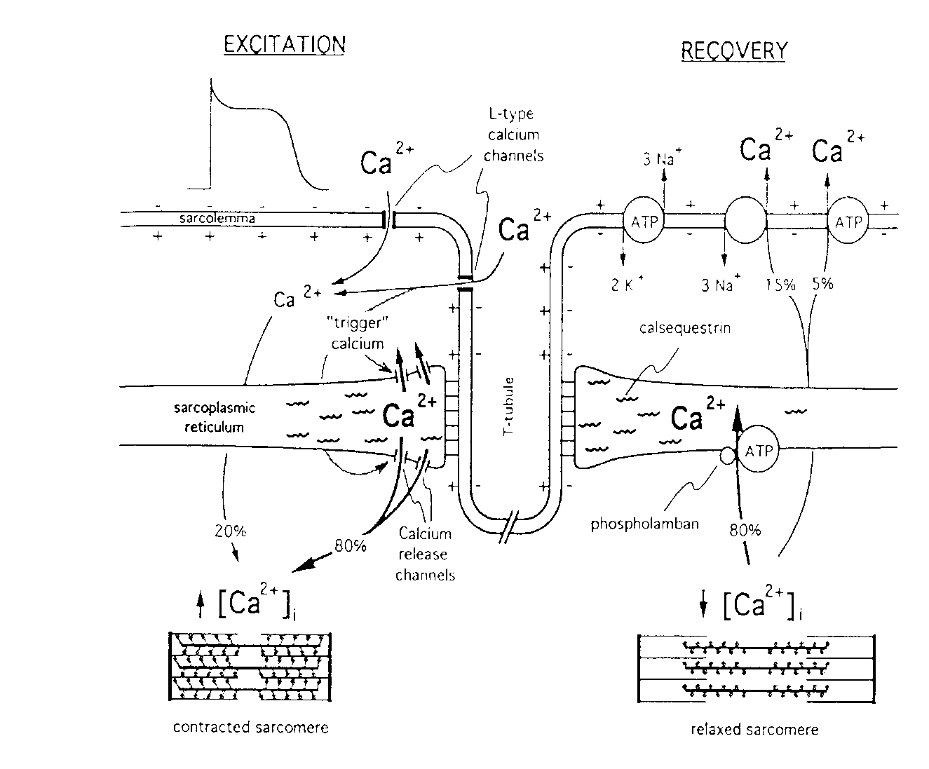
The higher the Ca²⁺ concentration achieved in the myoplasm during an action potential, the more forceful will be the resulting contraction. This is usually what positive inotropic drugs do.
Ca influx ends when action potential ends and SR Ca release terminates.
Ca is removed from the cytosol primarily by the SR Ca pump and the Na/Ca exchanger.
Contraction ends as cytosolic [Ca] falls

Slide 19
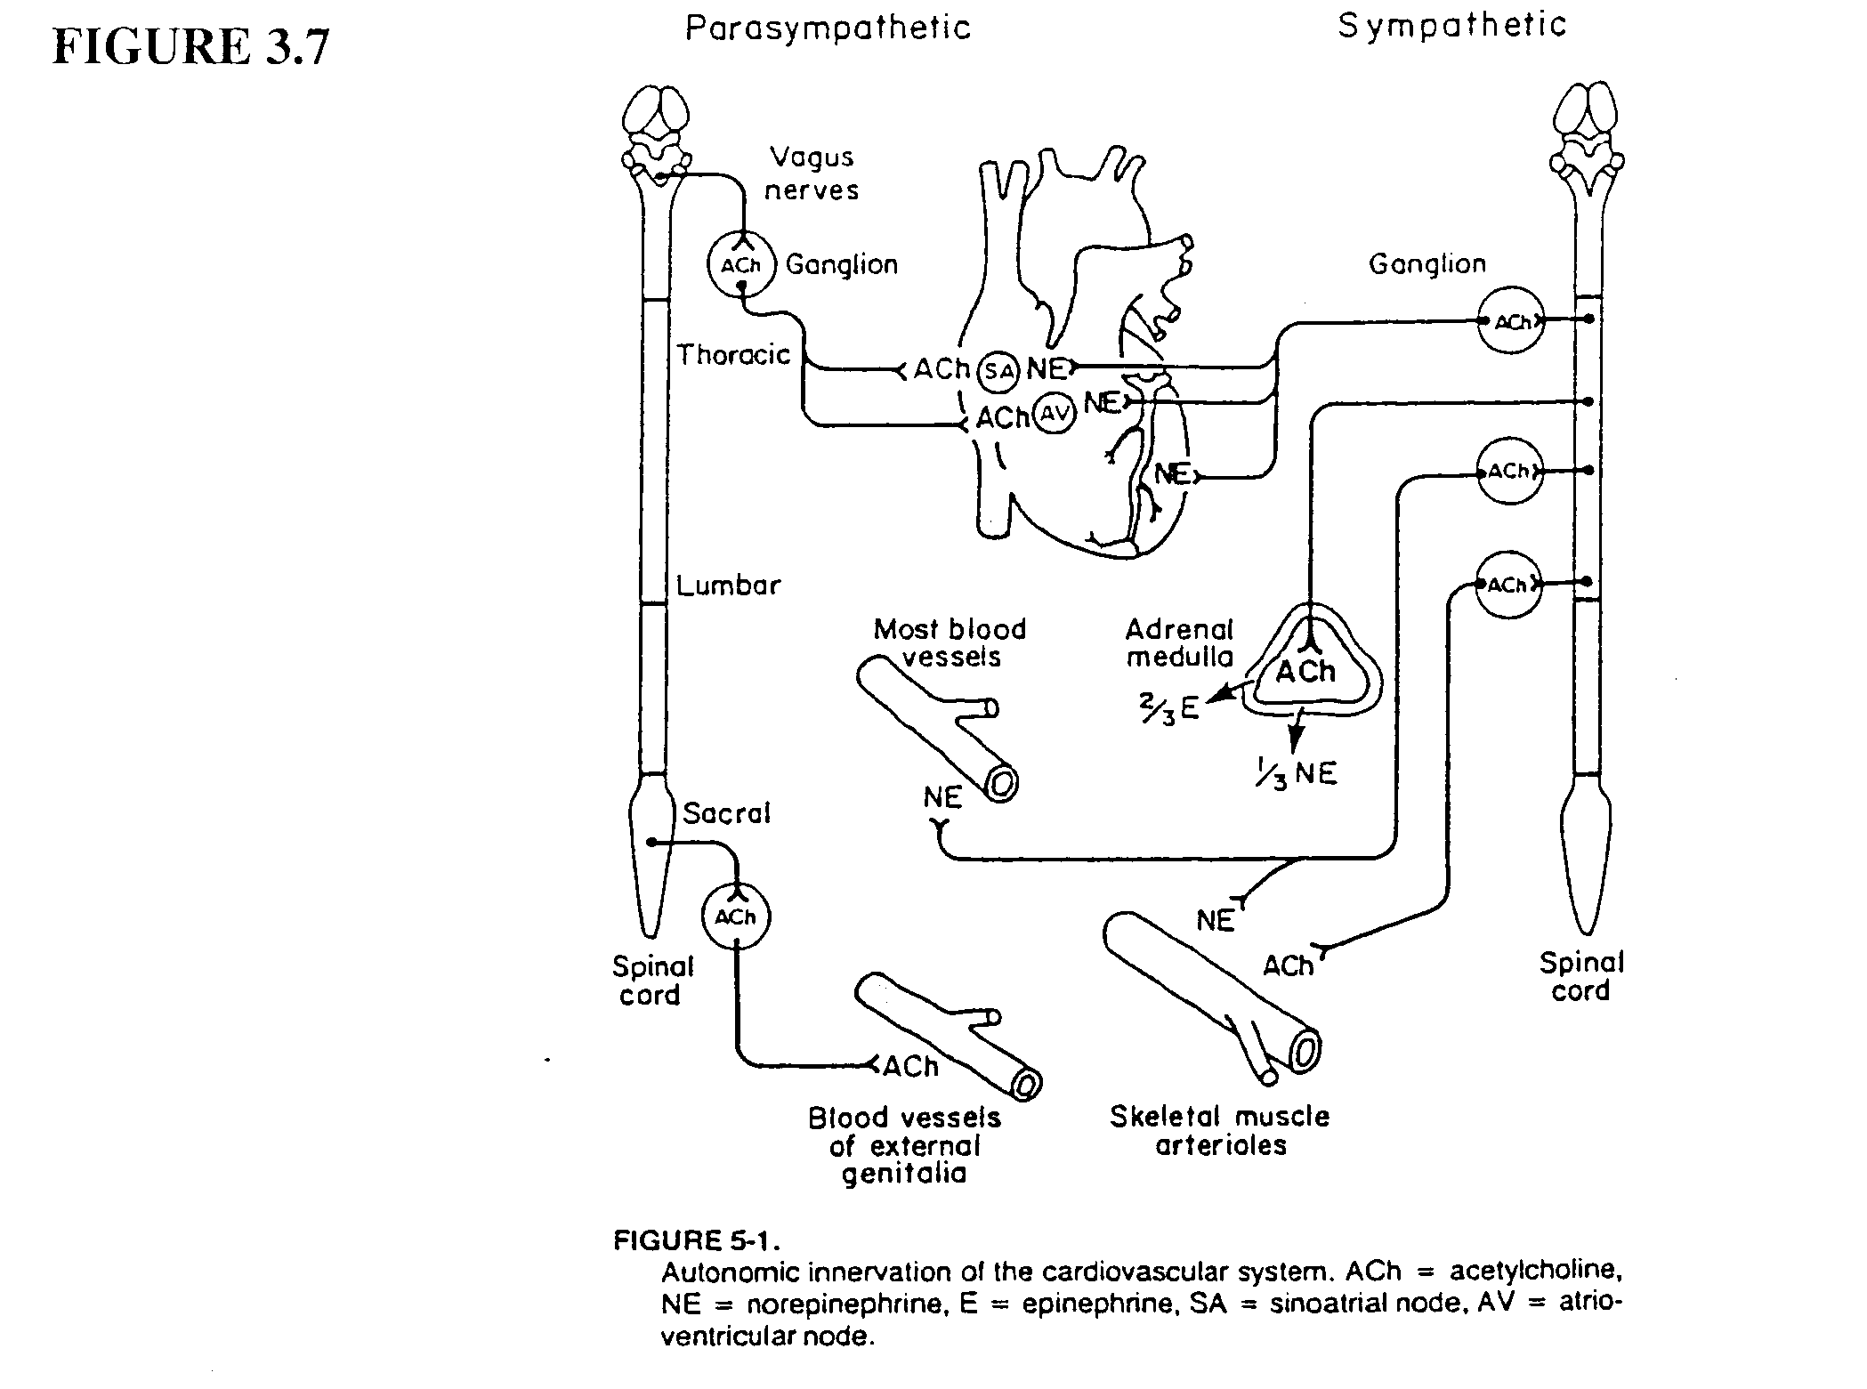
NE = norepinephrine (E = epinephrine)
Binds to β-adrenergic receptors (a G-protein coupled receptor, mostly β₁)
Positive chronotropic effect
Positive inotropic effect
Increased SR Ca pump activity
Ach = acetylcholine
Binds to M2 muscarinic receptors (also a G-protein coupled receptor)

Slide 20
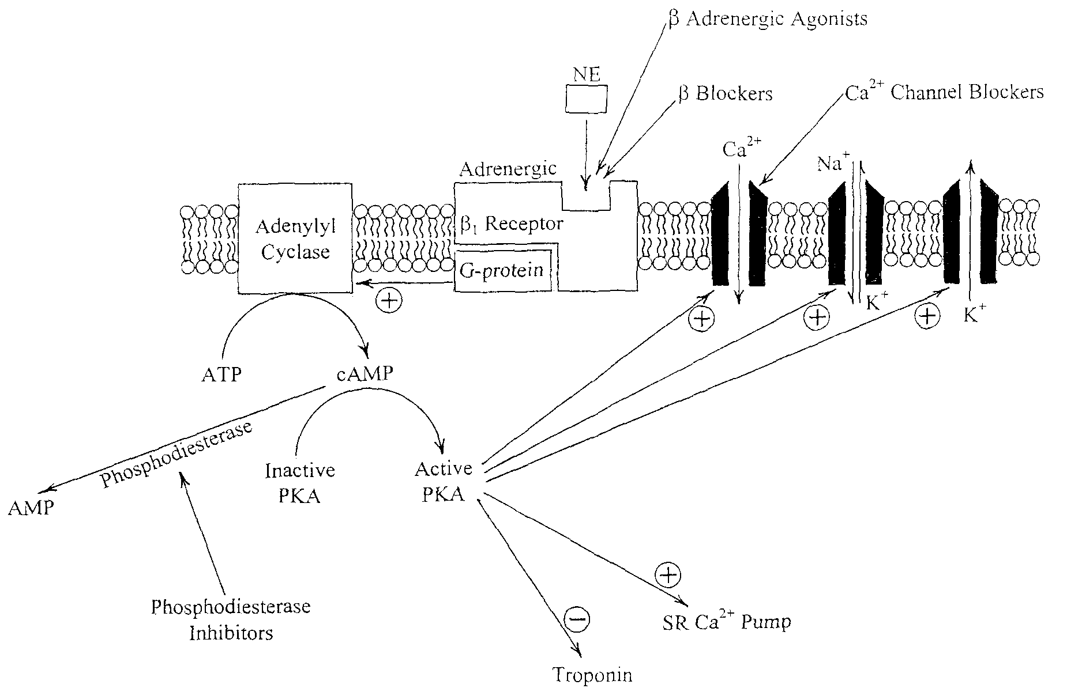
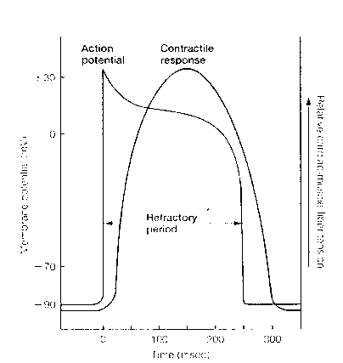

Slide 21
Choronotropic effect (SA node)
Inotropic effect (ventricle)
Increased Ca removal into the SR

Slide 22
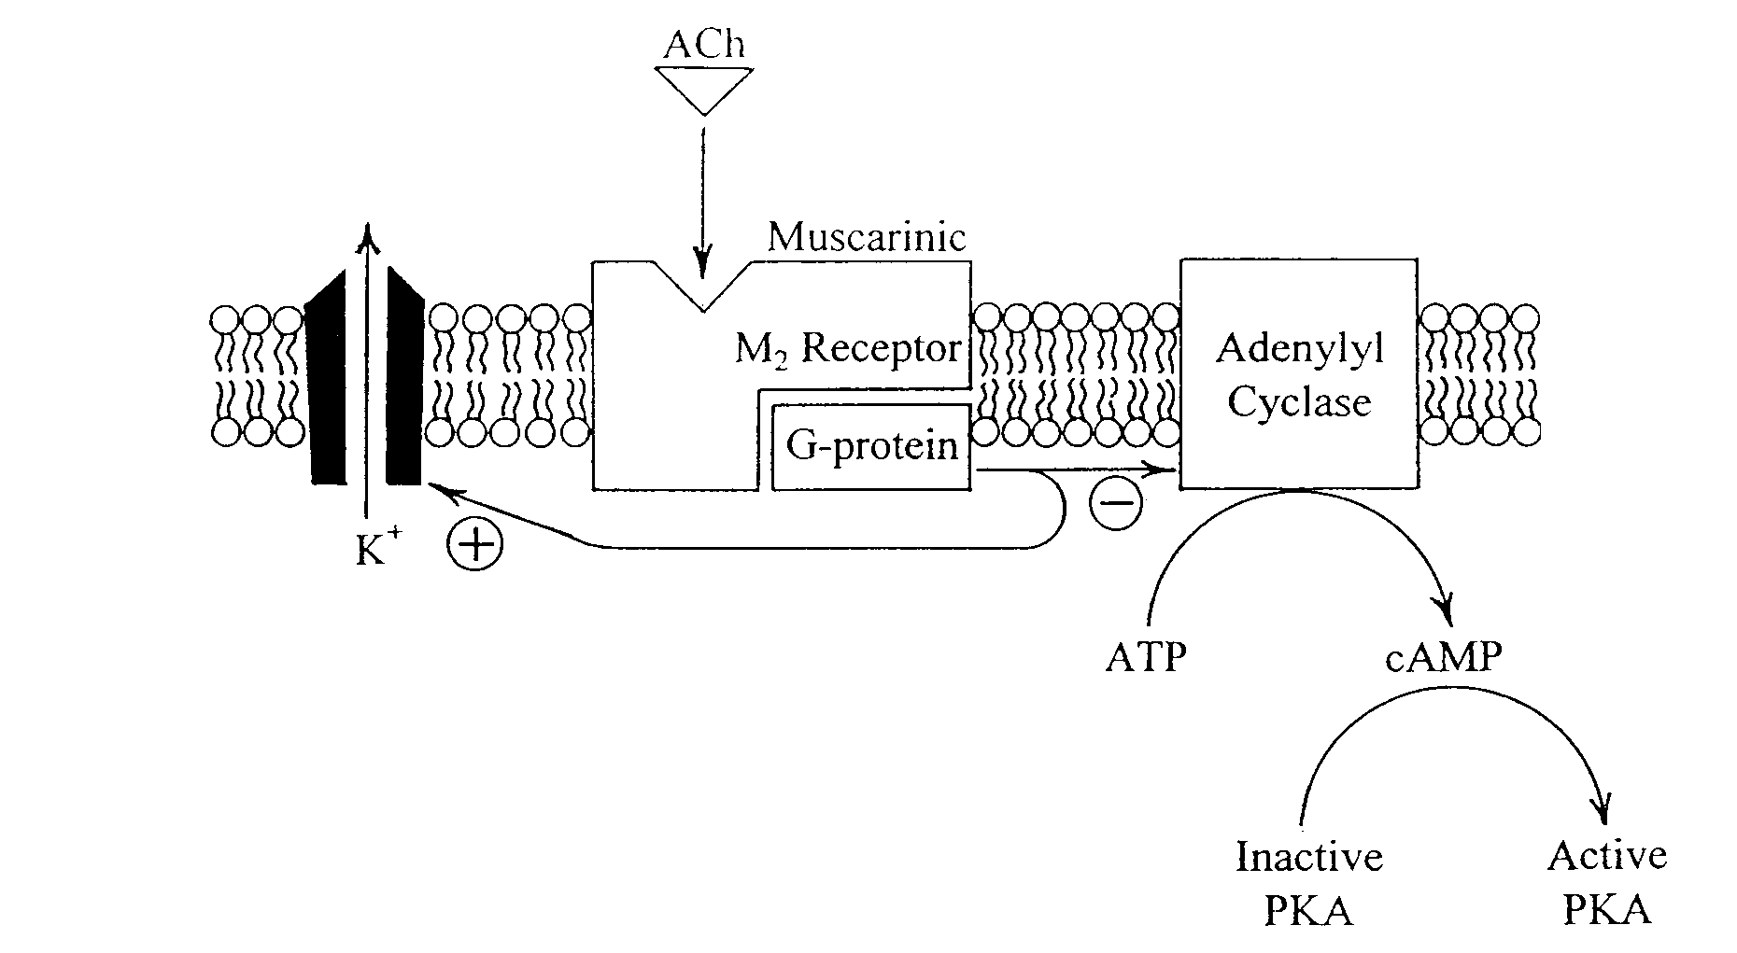
Decreased HR
Decreased force of contraction of the atria

Slide 23
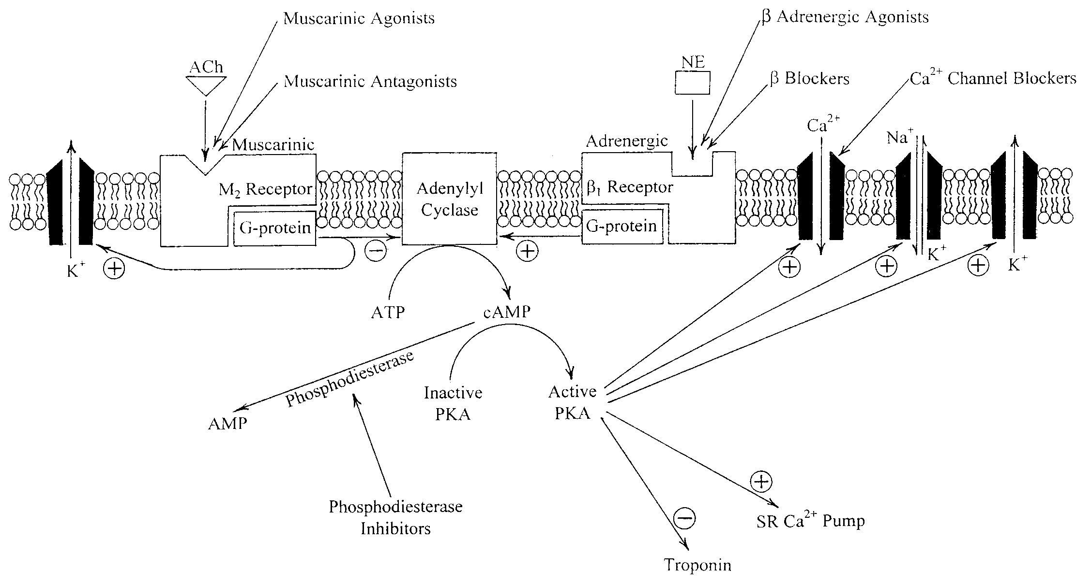
TONE

Slide 24
Inotropic Drugs
Sympathomimetic Amines
Dopamine
Dobutamine
Isoproterenol

Slide 25
Inotropic drugs illustrate the major effects that can result from seemingly minor modifications of the behavior of individual types of membrane protein molecules. Increased Ca entry leads to:
1. Higher myoplasmic Ca levels during the action potential, due to more Ca entering from the extracellular fluid or more release of Ca from the SR or (most commonly) both.
2. Higher myoplasmic Ca increases the force with which the heart contracts.
3. More forceful contraction of the heart leads to an increase in stroke volume.
4. Increased stroke volume leads to increased cardiac output (note that heart rate may also increase).
Increased cardiac output can lead to an increase in arterial pressure
Increased cardiac output and blood pressure can produce greater perfusion of the tissues of the body

